Slide 1


AN INTELLIGENT VEHICLE PRIORIZATION SYSTEM USING AI
K.RAMAKRISHNAN COLLEGE OF TECHNOLOGY (AUTONOMOUS), TRICHY
GUIDE NAME : Mr.R.ROSHAN JOSHUA.,M.E.
AP/AI
TEAM MEMBERS:
THEJEAL SRI K (811721243057)
SUJAINITHA G (811721243055)
DHIVYA A D (811721243014)
SATHVIKA A (811721243049)
1

Slide 2
OBJECTIVE
To design a system that detects emergency vehicles through CCTV footage using CNN and integrates audio classification of siren sounds via Mel-Frequency Cepstral Coefficients (MFCCs), improving detection even in occluded traffic situations.
2

Slide 3
PROBLEM DEFINITION
Existing System:
Traditional models ignore emergency vehicle (EMV) presence
AVs delay yielding, increasing EMV response times
Sudden lane changes cause slowdowns and risks
EMVs not prioritized in current traffic models
Limited adaptability to real-time traffic scenarios
Lacks deep learning in lane change decisions
Poor AV perception hampers safe EMV navigation
Traffic flow disrupted by delayed vehicle reactions
3

Slide 4
PROPOSED SYSTEM
Dual-mode detection using vision and audio
Deep learning identifies ambulance features and sirens
Smart signals adjust via wireless communication
AI automation ensures fast EMV passage
IoT enables real-time traffic data monitoring
Enhances emergency response through intelligent systems
No manual input needed for EMV priority
Integrates multiple technologies for smart traffic
4

Slide 5
LITERATURE SURVEY
S.NO | PAPER TITLE | AUTHOR NAME | YEAR PUBLISHED | TECHNIQUE USED | DEMERIT
1. | EVP-STC: Emergency vehicle priority and self – organisation traffic control at intersection using internet of things platform | Ajmal Khan, Farman Ullah, Zeeshan Kaleem, You-Ze Cho, Shamsurrahman. | 2020 | Fuzzy Logic, Genetic Algorithm (GA), Reinforcement Learning (RL), Dijkstra's | High implementation cost, reliance on real-time data accuracy
2. | RFID based smart traffic system for emergency vehicles . | Sathya D, C. Vinothini, S. Keerthi, Jagadeesan D, Nidhishree M S | 2022 | RFID-based Detection, Arduino-based Traffic Control. | Limited to vehicles equipped with RFID, requiring widespread adoption
5

Slide 6
S.NO | PAPER TITLE | AUTHOR NAME | YEAR PUBLISHED | TECHNIQUE USED | DEMERIT
3. | Smart city traffic management acoustic based vehicle detection using stacking – based ensemble deep learning approach | Ahsan Shabbir, Ibrahim M. Almanjahie, Ammaranawazcheema, Inamullah. | 2023 | Stacking Ensemble Deep Learning (MLP, DNN, LSTM | Computationally intensive, complex to implement,
4. | Emergency vehicle detection using IOT in smart cities | Mahesh Kumar Thota, Prathibhavani P.M, Shruthi Gujja, Decksha Ravula | 2023 | Computer Vision Algorithms, loT-based Detection, Edge Computing-based Processing | Requires high computational resources and infrastructure for deployment
6

Slide 7
S.NO | PAPER TITLE | AUTHOR NAME | YEAR PUBLISHED | TECHNIQUE USED | DEMERIT
5. | Cooridinate attention enhanced adaptive spatiotemporal convolutional network for traffic flow forecasting | Siwei Wei, Sichen Shen, Donghua Liu, Yanan Song, Rong Gao, Chunzhi Wang | 2024 | Spatio Temporal Graph Neural Networks (STGNN), Coordinate Attention Mechanism | High computational cost for real-time use.
6. | Real-Time Traffic Management with CNN-Based Emergency Vehicle Detection. | Wang.Z,Yadav.H | 2025 | CNN, Video Surveillance Analysis. | Challenges in dense, obstructed traffic conditions.
7

Slide 8
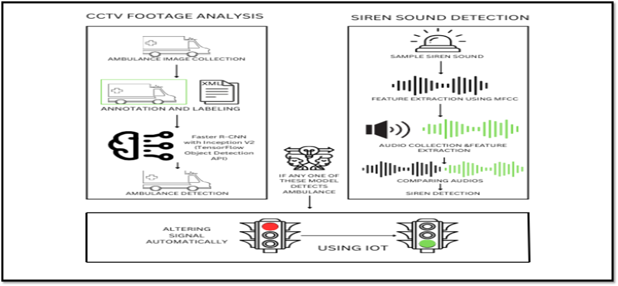
ARCHITECTURE DIAGRAM
8

Slide 9
SYSTEM & SOFTWARE SPECIFICATIONS
HARDWARE SPECIFICATION
System : PC OR LAPTOP
Processor : INTEL / AMD
RAM : 4 GB Recommended
ROM : 2 GB
SOFTWARE SPECIFICATION
Operating System : Windows 10/11
Language Used : Python
Backend : Python Script Window
Frontend : Python Shell
Software Description : Python, Tensorflow, Keras, Numpy, Pillow, Scikit-learn, Opencv, Convolutional Neural Network (CNN)
9

Slide 10
MODULES
Image Dataset preparation Module
Importing and Training Module
Capturing Module
Siren Detection Module
Traffic Signal Controller Module

Slide 11
IMAGE DATASET PREPARATION MODULE
Prepare a high-quality ambulance image dataset for deep learning models by collecting, preprocessing, and organizing data to enhance model accuracy and efficiency.
Image Dataset Collection
Gather images of ambulances from:
Real-world photography (cameras, drones)
Public datasets & web scraping
Crowdsourcing platforms
Ensure diverse conditions (lighting, weather, traffic) for model robustness.
11

Slide 12
Image Preprocessing
Resizing: Standardizes image dimensions for uniformity.
Renaming: Systematic naming for easy dataset management.
Normalization: Scales pixel values to improve model efficiency.
Augmentation: Applies transformations (rotation, flipping, brightness adjustments) to enhance generalization.
Image Labeling & Annotation
Organize images into labeled folders for classification tasks.
Use annotation tools like LabelImg, CVAT, and Roboflow to create bounding boxes & segmentation masks.
Save annotations in standard formats (COCO, Pascal VOC, YOLO) for CNN compatibility.
Validation Check: Ensure labeling accuracy for better model learning and generalization.
12

Slide 13
IMPORTING & TRAINING MODULE
Develop a deep learning model to accurately detect and classify ambulances in real-time using image processing techniques.
Importing Essential Modules
Purpose: Reuse code, enhance scalability, and simplify development.
Key Libraries Used:
TensorFlow/Keras – Deep learning model training
OpenCV – Image and video processing
NumPy & Pandas – Data handling and numerical operations
Matplotlib & Seaborn – Visualization
13

Slide 14
Training the Dataset
Data Preprocessing:
Collect and preprocess ambulance images (resizing, normalization, augmentation).
Split into training (70%), validation (20%), and testing (10%) sets.
Model Selection & Training:
Use CNN architectures like VGG, ResNet, or custom models.
Train on labeled images with optimized hyperparameters.
Evaluation & Testing:
Measure accuracy, precision, recall, and F1-score.
Validate model performance on unseen images.
14

Slide 15
CAPTURING MODULE
Detect and identify objects (e.g., ambulances) in real-time using a TensorFlow Object Detection model.
Model Loading & Initialization
Loads pre-trained object detection model (frozen_inference_graph.pb).
Uses label map utility to map category indices to class labels.
Initializes a TensorFlow session for inference.
Image Capture & Preprocessing
Captures frames from a live camera feed using OpenCV.
Saves frames as images for further processing.
Expands dimensions for compatibility with the TensorFlow model.
15

Slide 16
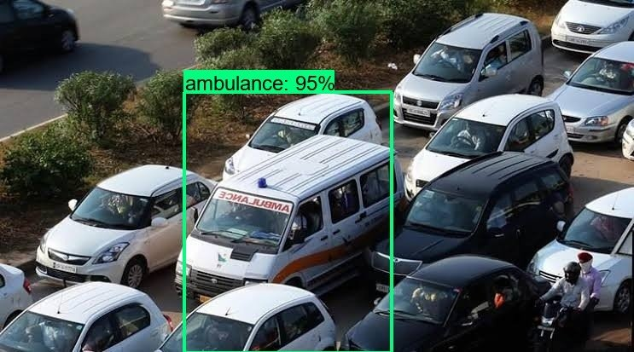
Object Detection & Classification
Extracts bounding boxes, classes, and scores using TensorFlow.
Matches detected objects against predefined class labels.
If an ambulance is detected with >70% confidence, it triggers an alert.
Visualization & Output
Draws bounding boxes on detected objects.
Displays live detection results in an OpenCV window.
Allows users to exit detection mode by pressing 'q'.
16

Slide 17
SIREN DETECTION
Identify and detect ambulance sirens in real-time using audio processing and machine learning techniques.
Reference Siren Sound Processing
Loads a pre-recorded ambulance siren (ambulance.mp3).
Extracts Mel-Frequency Cepstral Coefficients (MFCCs) to capture unique frequency patterns.
Converts the MFCCs into a flattened feature array for comparison.
Real-Time Audio Recording
Listens for siren sounds using sounddevice.
Records audio for 5 seconds at 22,050 Hz sampling rate.
Stores the captured audio in a NumPy array for analysis.
17

Slide 18
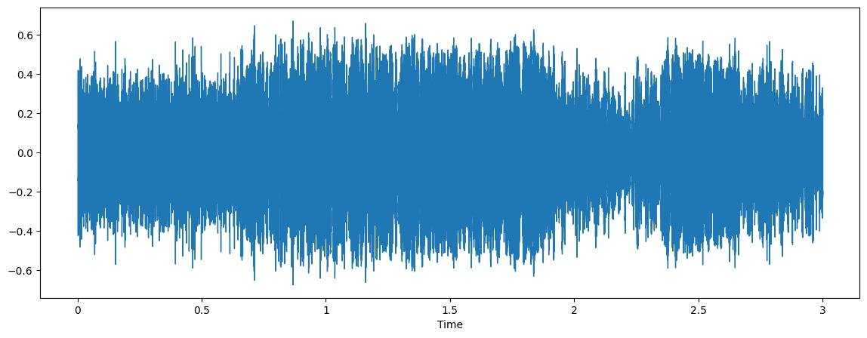
Feature Matching & Similarity Check
Extracts MFCCs from the recorded audio.
Matches reference and test feature arrays to ensure uniformity.
Computes the correlation distance between the two audio samples.
Siren Detection & Alert Mechanism
Compares the Similarity Score against a threshold (0.8).
If similarity is below the threshold → Ambulance Siren Detected!
Can be integrated with traffic systems for smart emergency response.
18

Slide 19
TRAFFIC SIGNAL CONTROLLER MODULE
To automate traffic signal control when an ambulance is detected, ensuring a smooth and prioritized passage.
Power Supply: Converts AC to regulated DC for circuit operation.
Transformer (Steps down voltage)
Rectifier (Converts AC to DC)
Smoothing & Regulator (Provides stable voltage)
Arduino Controller:
ATmega328 Microcontroller
Digital & Analog I/O Pins for signal control
Supports PWM, Serial, and SPI communication
19

Slide 20
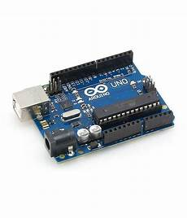
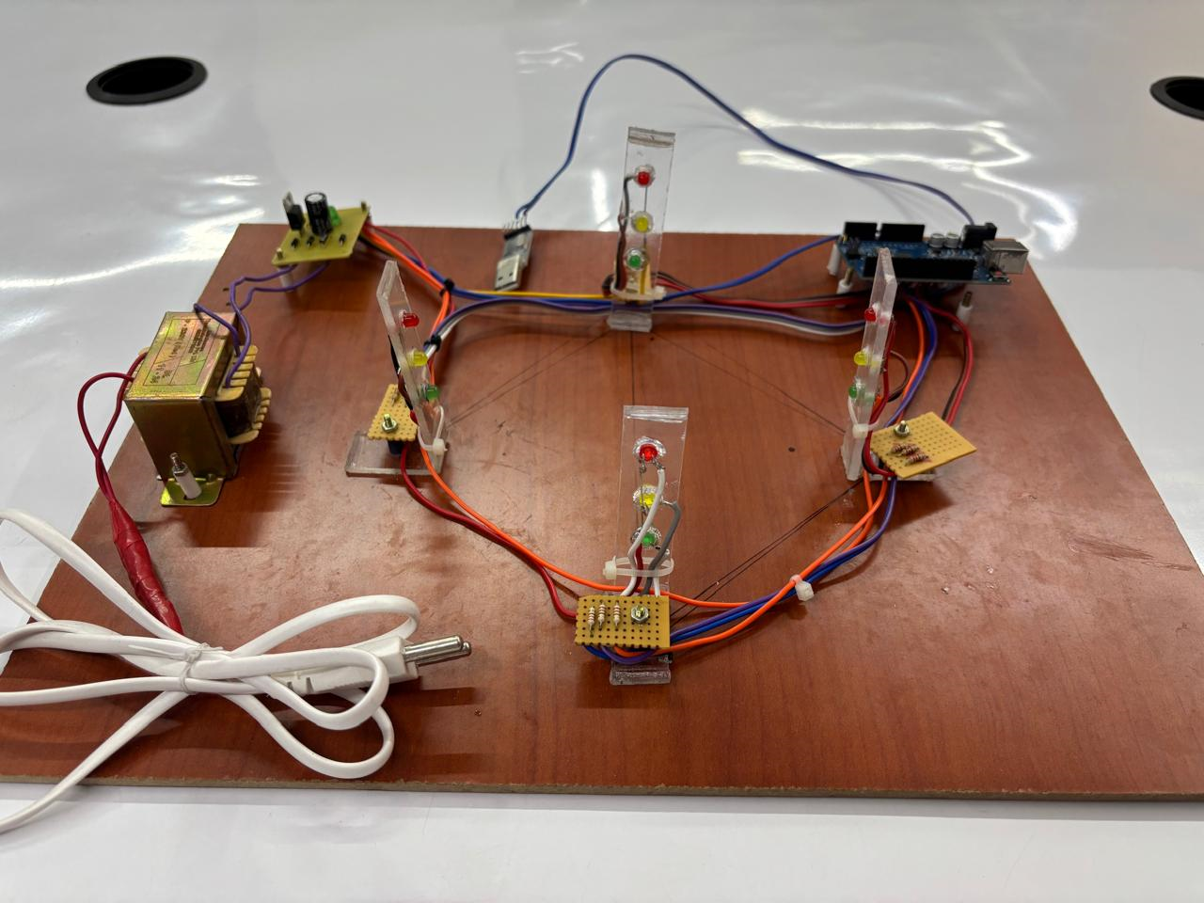
Step-by-Step Functionality:
Ambulance Detection:
Sensor or camera detects an approaching ambulance.
Signal Processing:
Arduino processes input and decides to change traffic signals.
Power Management:
Transformer steps down voltage → Rectifier converts AC to DC → Regulator stabilizes output.
Traffic Signal Control:
Arduino triggers green light for the ambulance lane and red for others.
20

Slide 21
ADVANTAGES
Faster Emergency Response – Minimizes traffic delays for ambulances.
AI-Based Ambulance Detection – Uses deep learning for accurate identification.
Dual Visual-Audio Identification – Detects emergency vehicles in poor visibility.
Smart Traffic Signal Control – Automates signal adjustments for efficiency.
Energy & Cost Efficiency – Reduces fuel wastage and emissions.
Reduced Traffic Delays – Optimizes routes for emergency vehicles.
22

Slide 22
APPLICATIONS
.
Smart Traffic Control – Prioritizes emergency vehicles at intersections.
Efficient Emergency Response – Clears paths for ambulances.
Faster Patient Transport – Reduces travel time to hospitals.
Support for Law Enforcement – Aids police in navigating traffic.
Disaster Management Aid – Helps response teams reach affected areas.
Automated Traffic Monitoring – Enables real-time traffic management
23

Slide 23
CONCLUSION
The Intelligent Vehicle Priorization System Using AI leverages computer vision, deep learning, and IoT-based automation to prioritize ambulance movement by adjusting traffic signals in real time. This enhances emergency response efficiency, road safety, and smart city infrastructure while reducing delays and optimizing urban mobility.
24

Slide 24
REFERENCES
Singh. A , Sharma. R (2023), Real-Time Emergency Vehicle Detection Using Convolutional Neural Networks, Vol. 21, pp. 1050-1062.
Rao S., Gupta K. (2023), Traffic Management System for Ambulance Detection Using CNN, Vol. 68, pp. 1124-1137.
Shah R., Yadav N. (2024), Efficient Emergency Vehicle Detection from CCTV Footage Using Deep Learning, Vol. 12, pp. 18023-18030.
Kumar A., Mehta V. (2024), CNN-Based Smart Traffic Light System for Emergency Vehicle Clearance, Vol. 8, pp. 1235-1246.
25

Slide 25
SCREENSHOTS
26

Slide 26
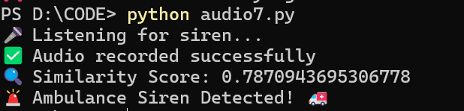
27

Slide 27
THANK YOU
28

